Slide 1
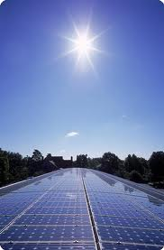
The Physics of Photovoltaics: Effectiveness and Efficiency

Slide 2
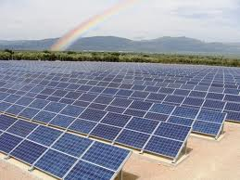
PHYSICS Mr. BALDWIN Modern Physics 5-21-14
AIM: How efficient and effective is “green” solution as a source of energy in new construction? (What is the photoelectric effect?)
DO NOW:
Describe the image below and what you think it’s being used for.

Slide 3
Aim: How efficient and effective is “green” solutions as a form of energy source in new construction?

Slide 4
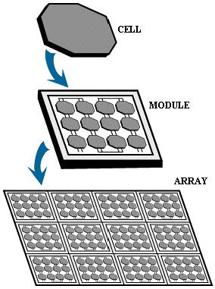
What is a Solar Cell
A single unit is referred to as a cell
A collection of cells is a module
A collection of modules is an array
http://science.nasa.gov/science-news/science-at-nasa/2002/solarcells/

Slide 5
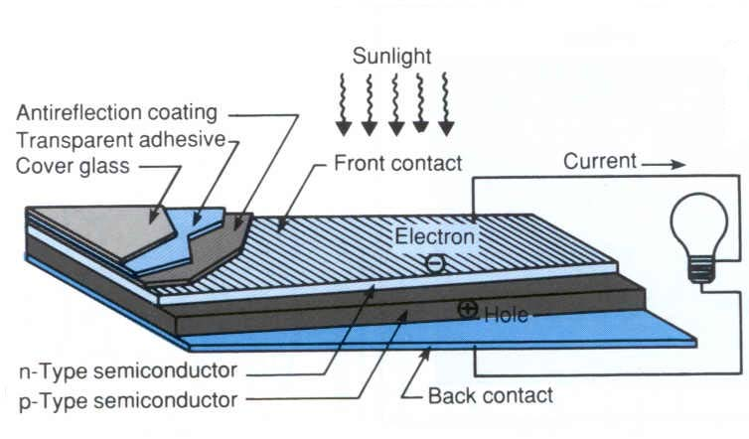
Overview:

Slide 6
How Solar Cells Work: The Photoelectric Effect
The basic principle of photovoltaics – the branch of solid state physics which has a focus of turning light into electrical energy
It is a property of certain materials where photons of light are absorbed and the energy causes electrons to be “knocked loose”
Those materials are referred to as semiconductors

Slide 7
THE PHOTOELECTRIC EFFECT
THIS IS THE EMISSION OF ELECTRONS FROM MATTER WHEN MATTER IS ILLUMINATED BY CERTAIN TYPES OF ELECTROMAGNETIC RADIATION.
IT WAS FIRST OBSERVED BY HEINRICH HERTZ IN 1887
http://phet.colorado.edu/en/simulation/photoelectric

Slide 8
The electromagnetic radiation releases electrons from the metal cathode. These electrons are attracted to the anode and complete a circuit allowing a current to flow
Radiation
Anode +ve
vacuum
Cathode -ve
electrons
mA
The p.d. across the tube measures the maximum kinetic energy of the ejected electrons in electron volts (eV).

Slide 9
Potassium metal undergoes photoemission with blue and green light, but not with red light.
e
Blue light
Emission!
Emission!
e
Green light
Red light
Nothing!!
potassium metal

Slide 10
THE CLASSICAL THEORY SUGGESTS TRYING MORE INTENSE LIGHT
Nothing!!
Nothing!!
potassium metal

Slide 11
The Classical Theory must be wrong!!!!!

Slide 12
Quantum Theory of the Photoelectric Effect
In 1905 Einstein developed Planck’s idea, that energy was quantized in quanta or photons, in order to explain the photoelectric effect.
Electromagnetic radiation is emitted in bursts of energy – photons. The energy of a photon is given by E = hf, where f is the frequency of the radiation and h is Planck’s constant. [h = 6.6 x 10⁻³⁴ Js]
But velocity of light = frequency times wavelength
Substituting
into E = hf

Slide 13
frequency
uv light < 400 nm
the visible spectrum
violet light light 400 nm
red light
light 700 nm
λ
Blue photon
Red photon
Which photon has the most energy ?????
BLUE !!!

Slide 14
Quantum Theory of the Photoelectric Effect
The photons are sufficient so that the whole quantum of energy [ hf ] can be absorbed by a single electron at one time.
The electron can then either
share its excess energy with other electrons or it can use the excess energy to fly out of the metal.
Because of the interaction of this electron with other atoms, it requires a certain minimum energy to escape from the surface.
The minimum energy required to escape depends on the metal and is called the work function, Φ.

Slide 15
For electron emission, the photon's energy has to be greater than the work function .
The maximum kinetic energy the released electron can have is given by:
E_{K} = photon energy – the work function.
E_{K} = hf - Φ
For every metal there is a threshold frequency, f₀, where hf₀ = Φ ,
that gives the photon enough energy to produce photoemission.
The number of photoelectrons emerging from the metal surface per unit time is proportional to the number of photons striking the surface that in turn depends on the intensity of the incident radiation
It follows that the photo electric current is proportional to the intensity of the radiation provided the frequency of radiation is above threshold frequency.

Slide 16
Based on some of the leading New York electric companies and New York’s average solar irradiance of 4.47 kWh/m² per day…paying $16,000 a month for a dorm electricity alone.
50% of Dorm Electricity
* Total Cost: $1,921,330 – $3,537,151
* Total Area: 40,460 – 73,436 sq m
* Average Monthly Savings: $8000
* Cost Payback: 15.00 – 23.09 years
100% of Dorm Electricity
* Total Cost: $3,903,911 - $7,135,553
* Total Area: 80,921 – 146,873 sq m
* Average Monthly Savings: $ 16,000
* Cost Payback: 15.4 – 23.22 years
Statistics Credit goes to Cooler Planet.com

Slide 17
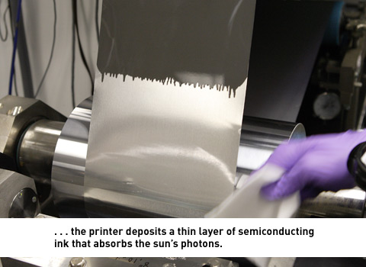
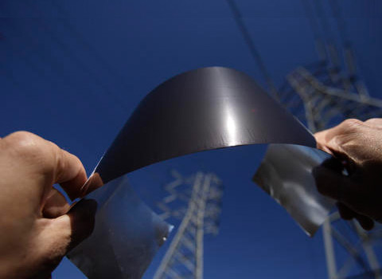
A company in California called Nanosolar (2007) has recently been mass-producing a thin film capable of producing high levels of energy from sunlight at a cost of one dollar per watt, competitive with coal. Compared to usual solar cells that require glass, aluminum, copper and silicon, these cells are a thin film consisting of five layers. http://www.popsci.com/popsci/flat/bown/2007/green/item_59.html
Future Technology: Thin Film Solar Energy

Slide 18
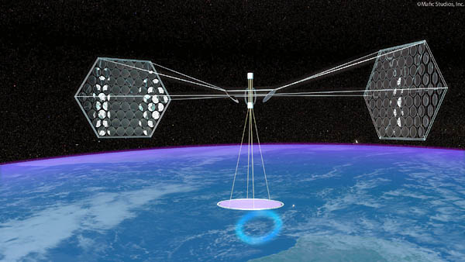
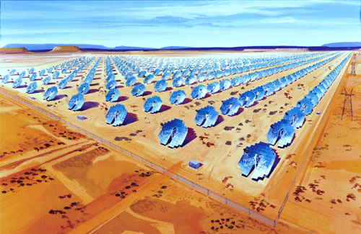
Future Applications
Constant trend of increasing efficiencies across all forms of solar cells
Inventive methods currently being considered include
*solar panels on satelites which beam the energy back to earth in the form of microwaves
*desert spanning solar farms
*laser sunlight collectors to focus sun rays right at the solar cells
http://www.maximumpc.com/article/news/solaren_quench_pges_energy_thirst_with_spacebased_solar_power
http://pneumaticaddict.wordpress.com/page/25/

