Slide 1
CHEMISTRY OCTOBER 16, 2014
ATOMIC CONCEPT
ATOMIC THEORY MODEL

Slide 2
SCIENCE STARTER
You are seated and quiet
You have 2 minutes
Draw your version of the atom in the box

Slide 3
NO QUIZ TOMORROW!

Slide 4
AIM
What is the size of an atom if the nucleus is the size of a basketball?

Slide 5
VOCABULARY
ATOM
NUCLEUS
ELECTRON CLOUD
ELECTRONS

Slide 6
ATOM
the basic units of matter and the defining structure of elements. It is composed of a nucleus and electron clouds

Slide 7
NUCLEUS
the positively charged center of an atom

Slide 8
ELECTRON CLOUD
the region of negative charge surrounding an atomic nucleus that is associated with an atomic orbital.

Slide 9
ELECTRON
the negatively charged component of an atom.

Slide 10
MOVEMENT IN ATOMS
How does the electron move around the nucleus?

Slide 11
DEMONSTRATION

Slide 12
MOVEMENT IN ATOM (ANSWER)
The electrons moved in an indefinite paths (buzzing around the nucleus like a swarms of bees)

Slide 13
ATTRACTION
Why do the electrons not drift off?

Slide 14
ATTRACTION (ANSWER)
The electrons are negatively charged particles that are attracted to the positively charged nucleus

Slide 15
SIZE OF NUCLUES
What is the size of a nucleus compared to an atom?

Slide 16
SIZE OF NUCLEUS (ANSWER)
Atom is about 10⁻¹⁰ meters
Nucleus is about 1 – 10 x 10⁻¹⁵ meters

Slide 17
WHAT IS ATOM MOSTLY MADE UP OF?
Empty space

Slide 18
COMPARING NUCLEUS TO ATOM
How much bigger is an atom to a nucleus

Slide 19
COMPARING NUCLUES TO ATOM
The nucleus is about 23000 – 145,000 times smaller than an atom depending upon the element
Uranium – 23,000 times
Hydrogen – 145,000 times

Slide 20
BASEBALL COMPARISON
Example: if the nucleus was a baseball, what is the size of the atom? What is the size of the electron?

Slide 21
BASEBALL COMPARISON
the atom will be about 4km
the electron will be about the size of a period.

Slide 22
TRY THIS
Tear a piece of paper 12 times.
Now tear it again 30 times.

Slide 23
BASKETBALL COMPARISON
How big is the atom if the nucleus is the size of a basketball?

Slide 24
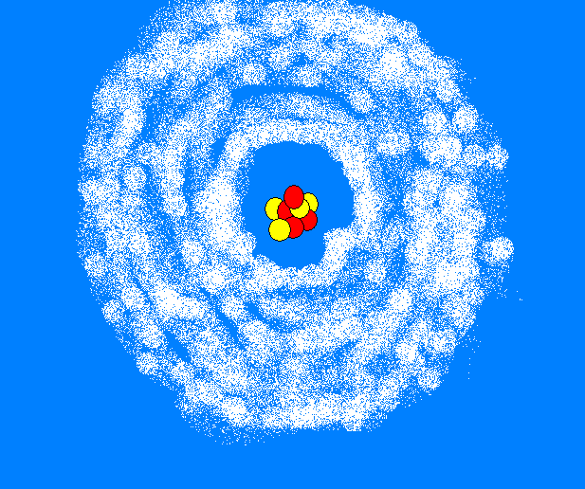
THE ATOMIC THEORY MODEL
Also known as the Wave-Mechanical Model

