Slide 1
CHEMISTRY December 18, 2014
LAB 08 – ALIEN PERIODIC TABLE

Slide 2
POP QUIZ
You may use the note from yesterday
You are seated and silent
You have 2 minutes

Slide 3
REMINDER
QUIZ ON FRIDAY

Slide 4
AIM
Explain, in terms of chemical reactivity, whether or not Mendeleev would be able to include Group 18 (Noble Gas Group) in his version of the Periodic Table. State your claim and explain.

Slide 5
PRELAB
Look at the Periodic Table and complete the table below by identifying 3 ways (arrangement method) in which you think the Periodic Table is arranged. Make sure to include an example for each of the way.

Slide 6
PRELAB
Arrangement Method | Example

Slide 7
ALIENS ARE HERE!
We woke up to an amazing event today. An alien spaceship has landed in Brooklyn. The aliens seem friendly and want to establish relations with Earth.

Slide 8
TASK
Our scientists want to have a better understanding of the aliens and need your help in organizing the aliens into an Alien Periodic Table. You will be working with a partner. This should take you about 10 minutes.

Slide 9
INSTRUCTIONS
Arrange the aliens into group
Every alien within a group must share one common feature (Key Similarity)
Every alien within a group must share a feature that changes regularly as you move down the group (Varying Trait)
Arrange the aliens into periods
Every alien within a period must share one common feature (Key Similarity)
Every alien within a period must share a feature that changes regularly as you move across the period (from left to right) (Varying Trait)

Slide 10
CHECK IN
Once you have completed arranging your alien cards into an Alien Periodic Table, call Ms. Bui over. She will verify that you have the correct arrangement. Make sure you can provide REASONS on your arrangement.

Slide 11
QUESTIONS
How many groups of Aliens do you have? _____________
How many periods of Aliens do you have? ____________

Slide 12
DATA TABLE
COMPLETE THE DATA TABLE BY PROVIDING KEY SIMILARITY AND VARYING TRAITS FOR EACH GROUPS AND PERIODS

Slide 13
DRAWING ACTIVITY
It has come to our attention that there are actually 2 more types of aliens on this planet.
The first type belongs in the first group but is a new period.
The second type belongs in the first period but is a new group.
Instruction: List 5 traits describing each type of alien and provide a drawing

Slide 14
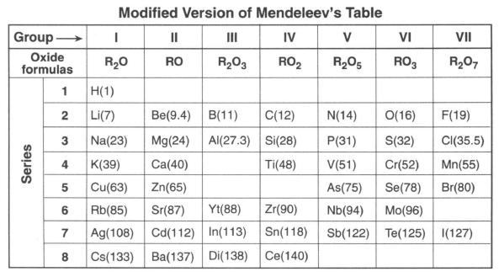

Slide 15
POST LAB Q1
Compare the Alien Periodic Table to the Elemental Periodic Table. List three similarities.

Slide 16
POST LAB Q2
Identify two characteristics used by Mendeleev to develop his classification system of the elements.

Slide 17
POST LAB Q3 AIM PROMPT
Explain, in terms of chemical reactivity, whether or not Mendeleev would be able to include Group 18 (Noble Gas Group) in his version of the Periodic Table. State your claim and explain.

